Slide 1
Shareholders' Equity - Accounting Principles
2022. 5.
Yangin Yoon

Slide 2
Agenda
Recap the previous class
Concept of equity
Stock
A statement of change in equity

Slide 3
Recap the previous class
Equity
Equities = Asset – Liability
Closing Entry
- After preparing the income statement, we add a closing entry.
- The final business results are accumulated through equity (e.g., Retained Earnings).
2021.12.31. (example)
Revenue $10,000
Interest Income $200
Cost of Goods $6,800
Salary Expense $2,000
Retained Earning $1,400

Slide 4
Equity
A company can acquire assets by using funds from either liabilities or equities.
Equities are usually involved in following events:
1) Establishing a company
2) Reporting net income
3) Providing dividends to shareholders
4) And other events

Slide 5
Equity
Equities are increased with following events:
1) Establishing a company
2) Making a positive profit (net-income)
2021.1.2. (example)
Cash $10,000
Capital Stock $10,000
2021.12.31. (example)
Revenue $10,000
Interest Income $200
Cost of Goods $6,800
Salary Expense $2,000
Retained Earning $1,400

Slide 6
Equity
Equities are decreased with following events:
1) Providing dividends
2) Reporting a loss (net-income)
2022.2.20. (example)
Retained Earning $500
Cash $300
2021.12.31. (example)
Revenue $10,000
Interest Income $200
Retained Earning $1,600
Cost of Goods $9,800
Salary Expense $2,000

Slide 7
Any Questions?

Slide 8
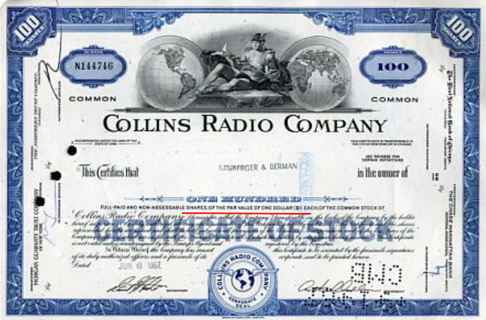
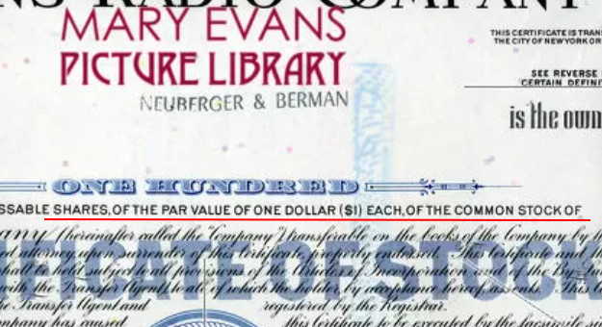
Stock (Equity)
A Stock represents ownership of an entity (i.e., corporation or company).
- A company issues stocks to its shareholders when it receives capital from shareholders.
- Usually, the stock has a par value.
https://www.prints-online.com/new-images-august-2021/stock-share-certificate-collins-radio-company-23044666.html

Slide 9


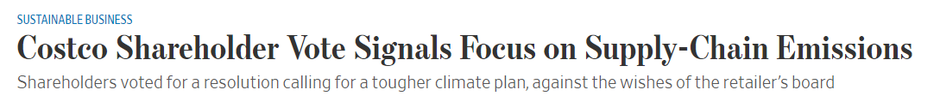
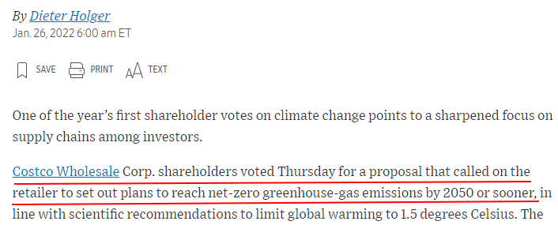
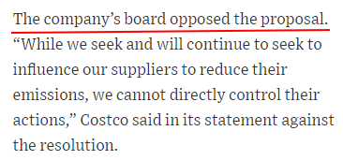
Stock (Equity)
A Stock represents ownership of an entity (corporation or company).
- The number of shareholder(s) can be one, two, or many.
- Important decision(s) is made by shareholders (shareholder vote).
https://www.wsj.com/articles/costco-shareholder-vote-signals-focus-on-supply-chain-emissions-11643194803
https://www.sec.gov/ix?doc=/Archives/edgar/data/0000909832/000119312522016856/d289189d8k.htm
https://www.reuters.com/business/toshibas-top-shareholder-vote-against-break-up-plan-2022-03-10/

Slide 10
Example - Stock (Equity)
In the very beginning, a company usually receives the exact amount of the par value from initial shareholders
Example
- Tom, Jane, and Sam established a company in 2021. The par value of one stock was $1. The total number of stock was 10,000 shares.
- Tom, Jane, and Sam invested their money to the company as shareholders. They put their money of $5000, $3000, and $2000, respectively.
→ And then, the net-income of the year 2021 was $2,000. There has been no dividend.
John wants to be another shareholder with 1,000 shares. How much money does he need to invest? $1000? Or more?
2021.1.2. (example)
Cash $10,000
Capital Stock $10,000

Slide 11
Example - Stock (Equity)
At the end of 2021, the total equities were $12,000. The total number of shares was 10,000.
John thought that the future of this company would be very bright. He was eager to be the shareholder of this company.
- The company offered to invest $1,500 for 1,000 shares. John agreed with it.
The company issued additional 1,000 shares and received $1,500 from John on 2022.1.3.
2022.1.3.
Cash $1,500
Capital Stock $1,000
Capital in excess of par value of stock $500
* “Capital in excess of par value of stock” is an equity type account.
“Paid-in capital in excess of par” means the same account.
https://www.sec.gov/Archives/edgar/data/37996/000003799621000012/f-20201231.htm#i50ca97c02686454fb096588b8c462fda_286

Slide 12
Any Questions?

Slide 13
Dividend
From the previous example, the net-income of the year 2022 was $5,000. There has been no dividend.
On 2023.2.5., the company decides to provide dividends $0.3 per share.
On 2023. 7. 25., the company decides to issue dividends 0.1 share per share
(stock dividend).
2023.2.5.
Retained Earning $3,300
Cash $3,300
* 11,000 (the number of total shares) × $0.3 = $3,300
2023.7.25.
Retained Earning $1,100
Capital Stock $1,100
* 11,000 (the number of total shares) × 0.1 = 1,100 (new shares)
** The par value of this stock is 1$. So, the Capital Stock for 1,100 shares is $1,100.
https://www.sec.gov/ix?doc=/Archives/edgar/data/0000909832/000119312522104414/d321332d8k.htm

Slide 14
A statement of change in equity
A statement of change in equity shows how the equities have been changed.
Change of the common stock (capital stock)
Change of “Capital in excess of par value of stock”
Change of the retained earning
Change of the OCI (Other Comprehensive Income)
https://www.sec.gov/ix?doc=/Archives/edgar/data/0000909832/000090983221000014/cost-20210829.htm

Slide 15
Chapter Summary
The concept of equity
Increase/Decrease of equity
Stock
- Par value of stock
- Number of stock
- Shareholder vote
Dividend
A statement of change in equity

Slide 16
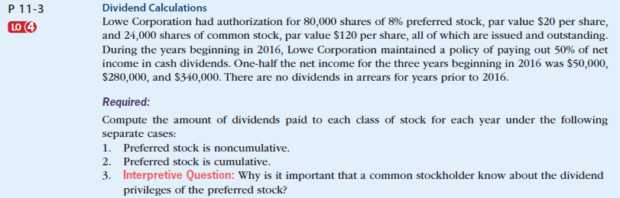
Equity (exercise)
Self-Study Material
© 2017 Cengage Learning, Principles of Financial Accounting, 2/E (IFRS Edition)

Slide 17
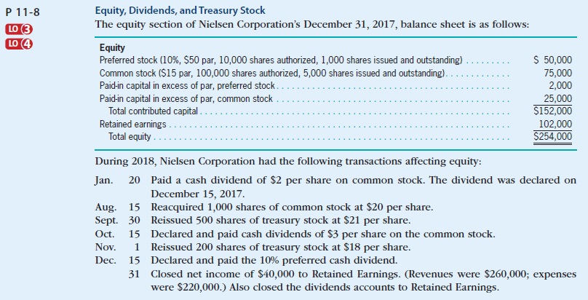

Equity (exercise)
Self-Study Material
© 2017 Cengage Learning, Principles of Financial Accounting, 2/E (IFRS Edition)

Slide 18
Any Questions?

